Slide 1
DataStage EE Architecture Basics:

Slide 2


Traditional Batch Processing:
Transform
Clean
Load
Operational Data
Disk
Disk
Disk
Data Warehouse
Archived Data
Source
Target
Traditional approach to batch processing:
Write to disk and read from disk before each processing operation.
Sub-optimal utilization of resources.
  A 10 GB stream leads to 70 GB of I/O.
  Processing resources can sit idle during I/O.
Very complex to manage (lots and lots of small jobs).
Becomes impractical with big data volumes.
  Disk I/O consumes the processing.
  Terabytes of disk required for temporary staging.
Notes:
The traditional data processing paradigm involves dropping data to disk many times throughout a processing run.

Slide 3

DataStage Architecture:
DataStage
Data Pipelining
Data Partitioning
Dual Parallelism
Source Data
Source Data
Source
Operational Data
Archived Data
Partitioning
Node 1
A - F
Transform
Transform
Transform
Node 2
Clean
Clean
G - M
Transform
Pipelining
Node 3
Load
Load
N - T
Transform
Data Warehouse
Node 4
Data Warehouse
U - Z
Transform
Target

Slide 4
Computing Architectures: Definition
Dedicated Disk
Shared Disk
Shared Nothing
Disk
Disk
Disk
Disk
Disk
Disk
Shared Memory
Memory
Memory
Memory
Memory
Memory
SMP System
(Symmetric Multiprocessor)
Uniprocessor
Clusters and MPP Systems
PC
Workstation
Single processor server
IBM, Sun, HP, Compaq
2 to 64 processors
Majority of installations
2 to hundreds of processors
MPP: IBM and NCR Teradata
each node is a uniprocessor or SMP

Slide 5
Scaleable Systems: Examples
Three main types of scalable systems:
Symmetric Multiprocessors (SMP): Shared Memory and Disk.
Clusters: UNIX systems connected via networks.
MPP: Massively Parallel Processing.
Notes:
You can describe an MPP as a bunch of connected SMPs.

Slide 6
SMP: Shared Everything
  Multiple CPUs with a single operating system.
  Programs communicate using shared memory.
  All CPUs share system resources (OS, memory with single linear address space, disks, I/O).
  When used with Enterprise Edition:
  Data transport uses shared memory.
  Simplified startup.
CPU
CPU
CPU
CPU
Notes:
A typical SMP machine has multiple CPUs that share both disks and memory.

Slide 7
Parallel Processing Systems:
DataStage EE Enables parallel processing = executing your application on multiple CPUs simultaneously
If you add more resources
(CPUs, RAM, and disks) you increase system performance.
1
2
3
4
Example system containing 6 CPUs (or processing nodes) and disks.
5
6
Notes:
DataStage Enterprise Edition can take advantage of multiple processing nodes to instantiate multiple instances of a DataStage job.

Slide 8
Performance: Parallel Execution
Current Systems
Critical Problems:
Meeting service level agreements.
Unexpected demand.
Optimizing hardware investments.
Alternative Solutions:
Manual partitioning.
Hand code threading.
Single thread bottleneck.
Land to disk between partitions.
Change program to incorporate changes to hardware.
Hand code parallel database and partition schemes.
Source Data
TRANSFORM ENRICH LOAD
Data
Warehouse
Real-time Enterprise Requirement
Notes:
High productivity development tools and the ability to understand data sources and create quality information is not enough if the data cannot be processed within the time frame available to the business. Having good data, late is almost as bad as having bad data early. That is why the Enterprise Integration Suite is built on a fully parallel architecture to enable your organization to meet its service level agreements with your users.

Slide 9
What is DataStage?
Design jobs for Extraction, Transformation, and Loading (ETL).
Ideal tool for data integration projects - such as, data warehouses, data marts, and system migrations.
Import, export, create, and managed metadata for use within jobs.
Schedule, run, and monitor jobs all within DataStage.
Administer your DataStage development and execution environments.
Notes:
DataStage is a comprehensive tool for the fast, easy creation and maintenance of data marts and data warehouses. It provides the tools you need to build, manage, and expand them. With DataStage, you can build solutions faster and give users access to the data and reports they need.
With DataStage you can:
· Design the jobs that extract, integrate, aggregate, load, and transform the data for your data warehouse or data mart.
· Create and reuse metadata and job components.
· Run, monitor, and schedule these jobs.
· Administer your development and execution environments.

Slide 10
Introduction to DataStage EE:
DSEE:
  Automatically scales to fit the machine
  Handles data flow among multiple CPU’s and disks
With DSEE you can:
  Create applications for SMP’s, clusters and MPP’s…
  Enterprise Edition is architecture-neutral
  Access relational databases in parallel
  Execute external applications in parallel
  Store data across multiple disks and nodes
Notes:
Enterprise Edition is architecturally neutral -- it can run on SMP's, clusters, and MPP's. The configuration file determines how Enterprise Edition will treat the hardware.

Slide 11
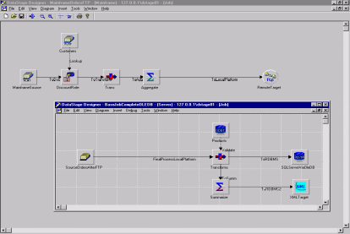
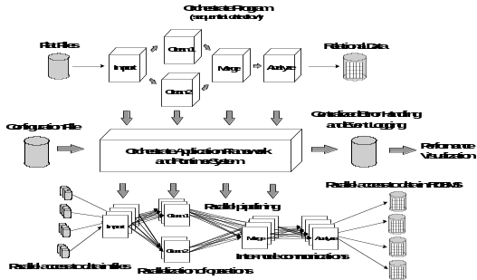
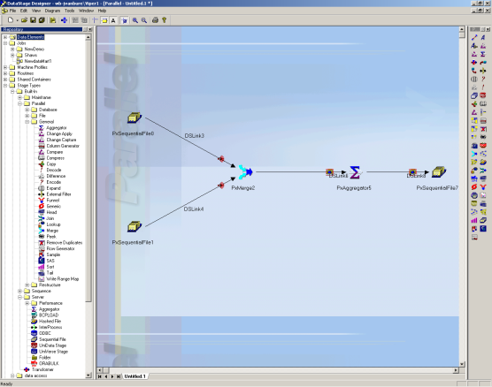
DataStage EE Architecture:
DataStage Engine :
Provides data integration platform
Orchestrate Framework :
Provides parallel processing
DataStage Enterprise Edition :
Best-of-breed scalable data integration platform
No limitations on data volumes or throughput
Notes:
The enterprise edition engine was derived from DataStage and Orchestrate.

Slide 12
Why EE is so Effective?
Parallel processing paradigm
  More hardware, faster processing
  Level of parallelization is determined by a configuration file read at runtime
Emphasis on memory
  Data read into memory and lookups performed like hash table
Notes:
EE takes advantage of the machines hardware architecture -- this can be changed at runtime.

Slide 13
EE Program Elements:
  Data Set: Uniform set of rows in the Framework's internal representation.
  Three flavors:
  file sets: *.fs : stored on multiple Unix files as flat files
  persistent: *.ds : stored on multiple Unix files in Framework format
  read and written using the DataSet Stage
  virtual: *.v : links, in Framework format, NOT stored on disk
  The Framework processes only datasets—hence possible need for Import.
  Different datasets typically have different schemas.
  Convention: "dataset" = Framework data set.
Partition: Subset of rows in a dataset earmarked for processing by the same node (virtual CPU, declared in a configuration file).
All the partitions of a dataset follow the same schema: that of the dataset
Notes:
Enterprise Edition deals with several different types and data:
file sets
data sets -- both in persistent and non-persistent forms.

Slide 14




Job Design VS. Execution:
Developer assembles data flow using the Designer.
…and gets: parallel access, propagation, transformation, and load.
The design is good for 1 node, 4 nodes, No need to modify or recompile the design
Notes:
Much of the parallel processing paradigm is hidden from the programmer -- they simply designate process flow as shown in the upper portion of this diagram. Enterprise Edition, using the definitions in that configuration file, will actually execute UNIX processes that are partitioned and parallelized.

Slide 15
Partitioners and Collectors:
Partitioners distribute rows into partitions
  implement data-partition parallelism
Collectors = inverse partitioners
Live on input links of stages running
  in parallel (partitioners)
  sequentially (collectors)
Use a choice of methods
Notes:
Partitioners and collectors work in opposite directions -- however, many are frequently together in job designs.

Slide 16
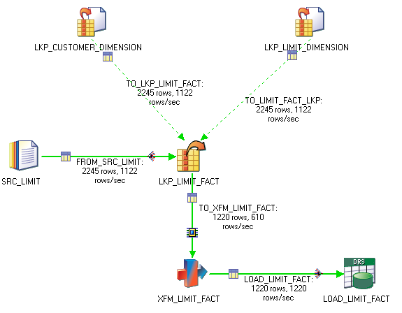
Example Partitioning Icons:
Partitioner
Collector

Slide 17
IBM WebSphere DataStage Overview:
DataStage Administrator
DataStage Manager
DataStage Designer
DataStage Director

Slide 18
Tool Functions:
Administrator : Add/delete projects, set defaults
Manager : Import meta data, backup projects
Designer : Assemble jobs, compile, and execute
Director : Execute jobs, examine job run logs
Notes:
A typical DataStage workflow consists of:
Setting up the project in Administrator
Including metadata via Manager
Building and assembling the job in Designer
Executing and testing the job in Director.

Slide 19
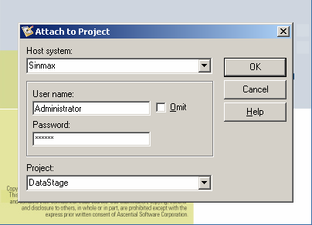
Client Logon:

Slide 20
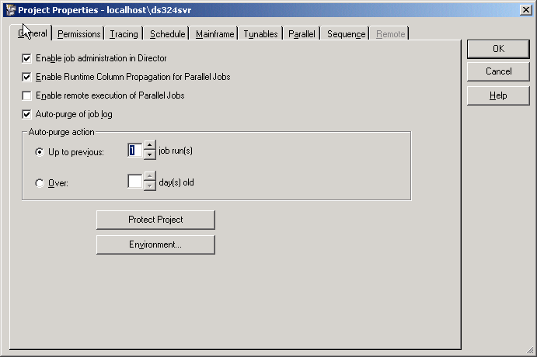
DataStage Administrator:
Notes:
Use the Administrator to specify general server defaults, add and delete projects, and to set project properties. The Administrator also provides a command interface to the UniVerse repository.
· Use the Administrator Project Properties window to:
· Set job monitoring limits and other Director defaults on the General tab.
· Set user group privileges on the Permissions tab.
· Enable or disable server-side tracing on the Tracing tab.
· Specify a user name and password for scheduling jobs on the Schedule tab.
· Specify hashed file stage read and write cache sizes on the Tunables tab.

Slide 21
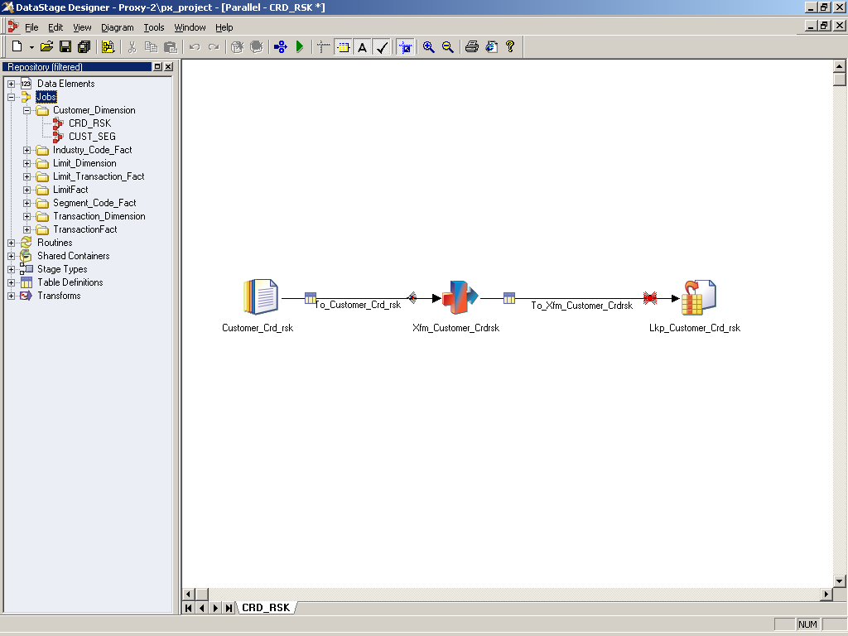
DataStage Designer:

Slide 22
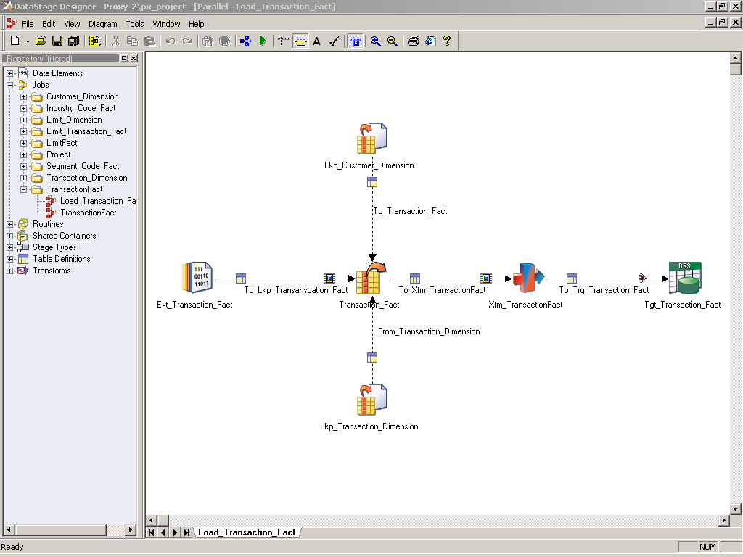
Designer Work Area:

Slide 23
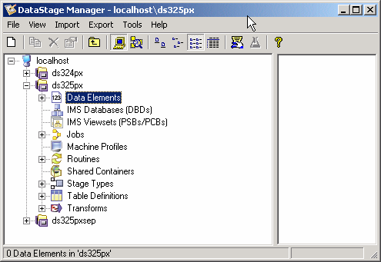
DataStage Manager:
Notes:
Use the Manager to store and manage reusable metadata for the jobs you define in the Designer. This metadata includes table and file layouts and routines for transforming extracted data.
Manager is also the primary interface to the DataStage repository. In addition to table and file layouts, it displays the routines, transforms, and jobs that are defined in the project. Custom routines and transforms can also be created in Manager.

Slide 24
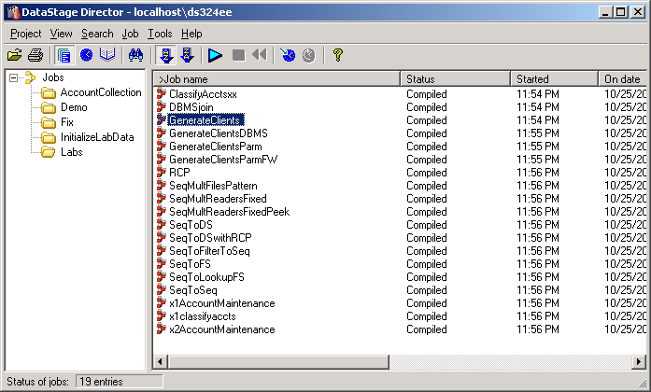
DataStage Director:
Notes:
Use the Director to validate, run, schedule, and monitor your DataStage jobs. You can also gather statistics as the job runs.

Slide 25
ETL Process Overview:
Metadata mapping
Extraction
Transformation
Loading

Slide 26
Metadata Mapping:
Understand how EE uses meta data, particularly schemas and runtime column propagation.
Use this understanding to:
  Build schema definition files to be invoked in DataStage jobs
  Use RCP to manage meta data usage in EE jobs

Slide 27
Data Types:
Date
Decimal
Floating point
Integer
String
Time
Timestamp
Vector
Subrecord
Raw
Tagged
Notes:
Raw – collection of untyped bytes
Vector – elemental array
Subrecord – a record within a record (elements of a group level)
Tagged – column linked to another column that defines its datatype

Slide 28
Schema:
Alternative way to specify column definitions for data used in EE jobs.
Written in a plain text file.
Can be written as a partial record definition.
Can be imported into the DataStage repository.
Notes:
The format of each line describing a column is:
column_name:[nullability]datatype

Slide 29
Creating a Schema:
Using a text editor
  Follow correct syntax for definitions
  OR
Import from an existing data set or file set
  On DataStage Manager import > Table Definitions > Orchestrate Schema Definitions
  Select checkbox for a file with .fs or .ds

Slide 30
Exercise 1:
Importing a schema Using text editor, Existing data set or file set, Database.

Slide 31
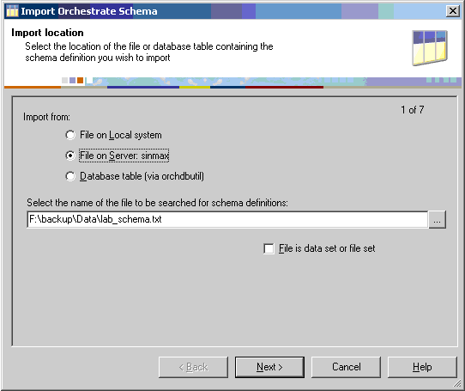
Importing a Schema:
Schema location can be on the server or local work station

Slide 32
Runtime Column Propagation:
DataStage EE is flexible about meta data. It can cope with the situation where meta data isn’t fully defined. You can define part of your schema and specify that, if your job encounters extra columns that are not defined in the meta data when it actually runs, it will adopt these extra columns and propagate them through the rest of the job. This is known as runtime column propagation (RCP).
RCP is always on at runtime.
Design and compile time column mapping enforcement.
  RCP is off by default.
  Enable first at project level. (Administrator project properties)
  Enable at job level. (job properties General tab)
  Enable at Stage. (Link Output Column tab)

Slide 33
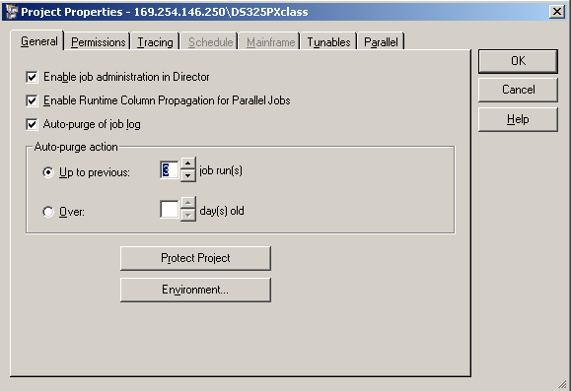
Enabling RCP at Project Level:

Slide 34
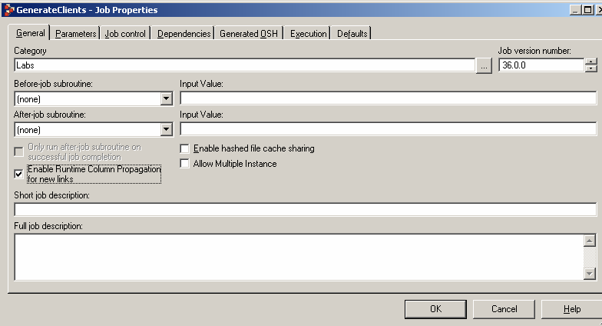
Enabling RCP at Job Level:

Slide 35
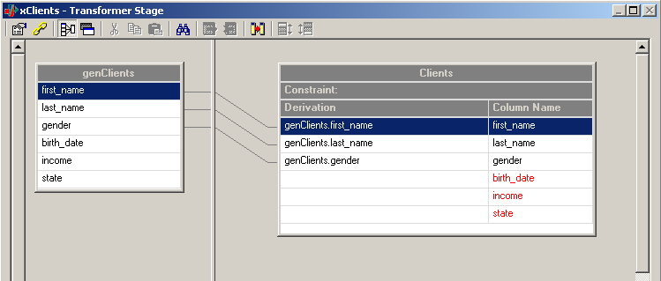
Enabling RCP at Stage Level:
Go to output link’s columns tab.
For transformer you can find the output links columns tab by first going to stage properties.

Slide 36
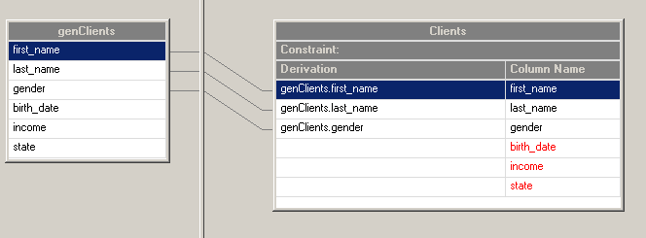
Runtime Column Propagation:
When RCP is Disabled
  DataStage Designer will enforce Stage Input Column to Output Column mappings.
  At job compile time modify operators are inserted on output links in the generated OSH.
Notes:
Modify operators can add or change columns in a data flow.

Slide 37
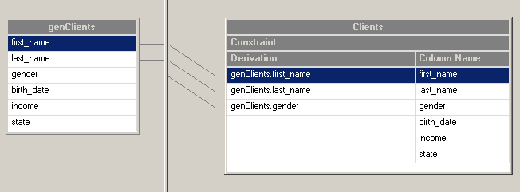
Runtime Column Propagation:
When RCP is Enabled
  DataStage Designer will not enforce mapping rules.
  No Modify operator inserted at compile time.
  Danger of runtime error if column names incoming do not match column names outgoing link – case sensitivity.

Slide 38
Merits of RCP:
RCP is useful when you are dealing with hundreds of columns.
RCP can be very useful is in the case of a complex program with more stages, i.e., the more places you have to correct table definitions.
With RCP you change it once at the beginning and the changes will flow through the rest of the program.
RCP is a feature of the base orchestrate framework.
It cannot be switched "off". What actually happens when RCP is switched off is an implicit Modify operator is added after every stage that changes column definitions. This may mean potentially doubling the number of operators in your job causing performance hits.

Slide 39
Demerits of RCP:
RCP should be switched off at certain stages in your job where leaving it on will cause all those headaches (Defaulting, dropping issues). Example of such a stage would be funnel.
A recommended best practice is to document through annotations where in the job RCP has been switched off.
you can write jobs that contain no column metadata.

Slide 40
Exercise 2:
Using RCP and using no RCP

Slide 41
Data Capture Methods:
All Data
Changed Data
Push to Warehouse
Pull from Source

Slide 42

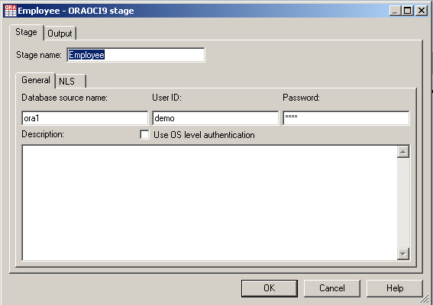
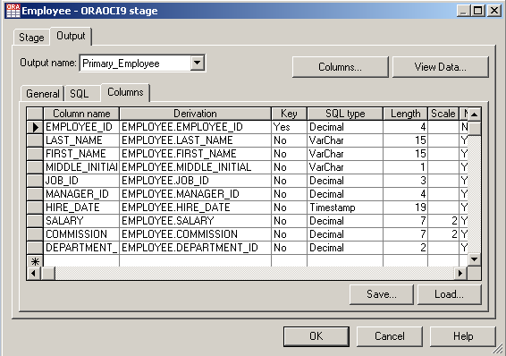
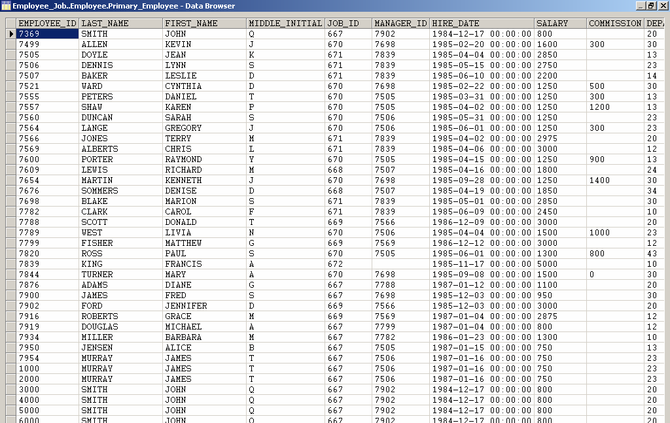
Pull all Data – Database:
Database Connection Properties
Metadata
View data

Slide 43

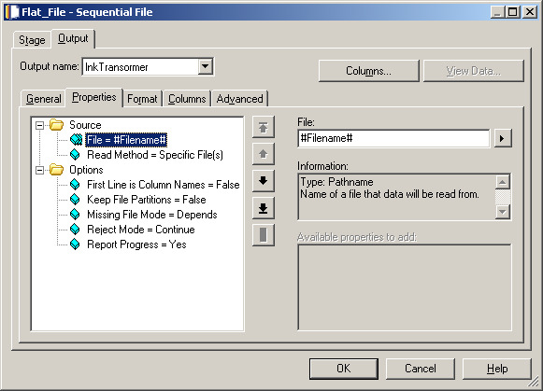
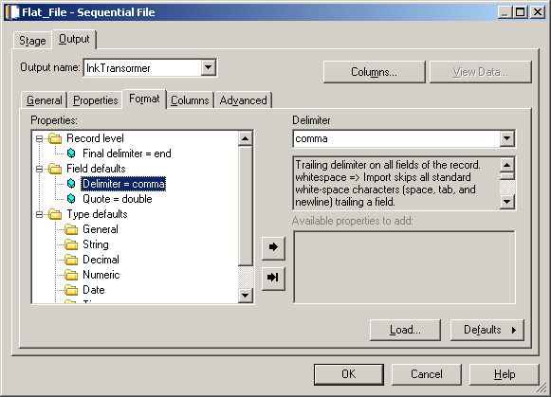
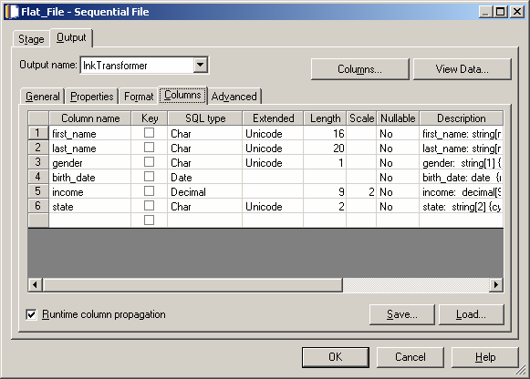
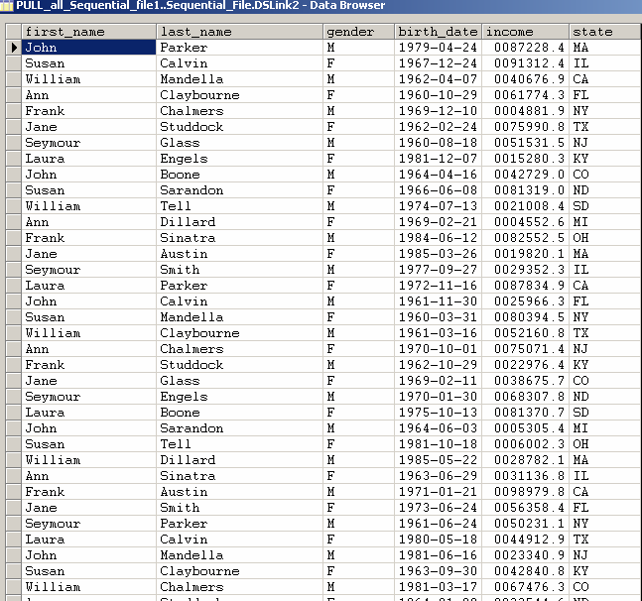
Pull all Data – Flat files :
Location of the input file
Format
Metadata
View data

Slide 44
Exercise 3:
Pulling Source data from Files, Tables.

Slide 45
Extraction Stages:
DB Stages
Sequential Stage
FileSet
Lookup FileSet
Dataset
Change Capture

Slide 46
RDBMS Access Supported Databases:
Enterprise Edition provides high performance / scalable interfaces for:
DB2
Informix
Oracle
Teradata

Slide 47
RDBMS Access
Automatically convert RDBMS table layouts to/from Enterprise Edition Table Definitions.
RDBMS nulls converted to/from nullable field values.
Support for standard SQL syntax for specifying:
  field list for SELECT statement
  filter for WHERE clause
Can write an explicit SQL query to access RDBMS.
EE supplies additional information in the SQL query.
Notes:
RDBMS access is relatively easy because Orchestrate extracts the schema definition for the imported data set. Litle or no work is required from the user.

Slide 48
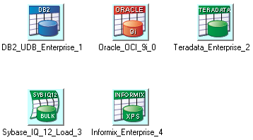
RDBMS Stages:
DB2/UDB Enterprise
Informix Enterprise
Oracle Enterprise
Teradata Enterprise

Slide 49
RDBMS Usage:
As a source:
  Extract data from table (stream link)
      User-defined can perform joins, access views
      Extract as table, generated SQL, or user-defined SQL
  Lookup (reference link)
      Normal lookup is memory-based (all table data read into memory)
      Can perform one lookup at a time in DBMS (sparse option)
      Continue/drop/fail options
As a target:
  Inserts
  Upserts (Inserts and updates)
  Loader

Slide 50
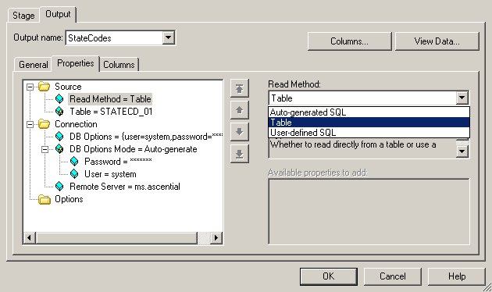
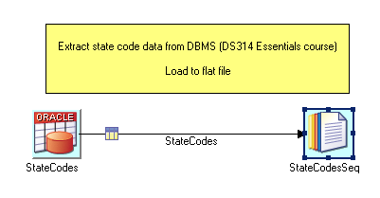
RDBMS Source – Stream Link:
Stream link

Slide 51
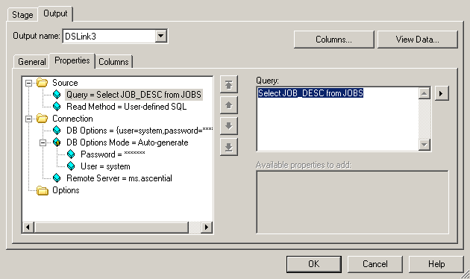
DBMS Source - User-defined SQL:
Columns in SQL statement must match the meta data in columns tab

Slide 52
Exercise-4:
Reading multiple files with pattern
&
Reading fixed width file with number of readers.

Slide 53
Exercise-5:
Using user-defined Query

Slide 54
Transformation Process:
Select
Filter
Convert / Translate
Derive
Summarize
Exceptions / Rejections

Slide 55
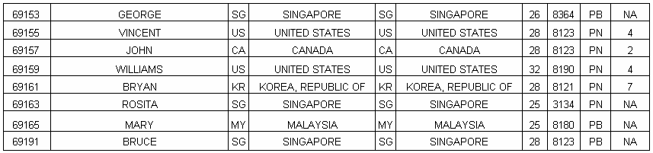
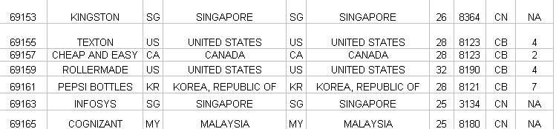


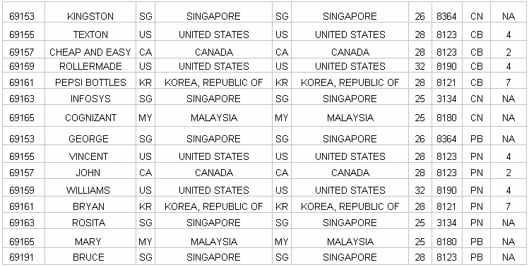
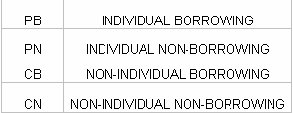
Selection:
Input 1
Input 2
Output

Slide 56
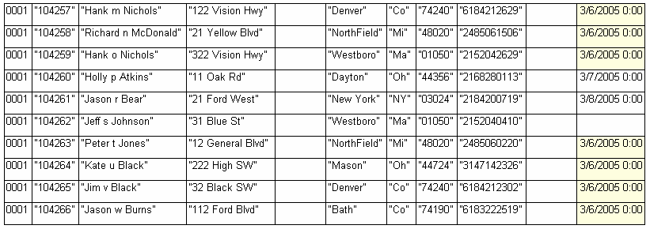
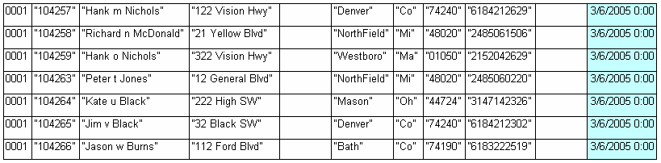

Filter:
Transformed Rows
Discarded Rows

Slide 57
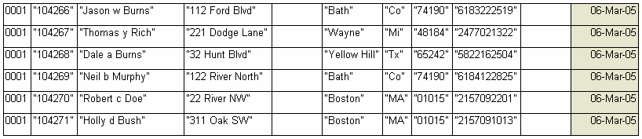
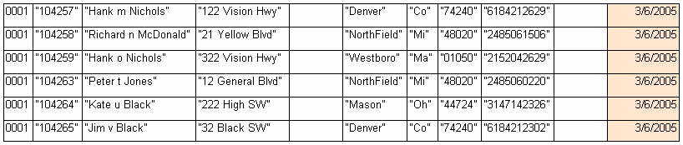
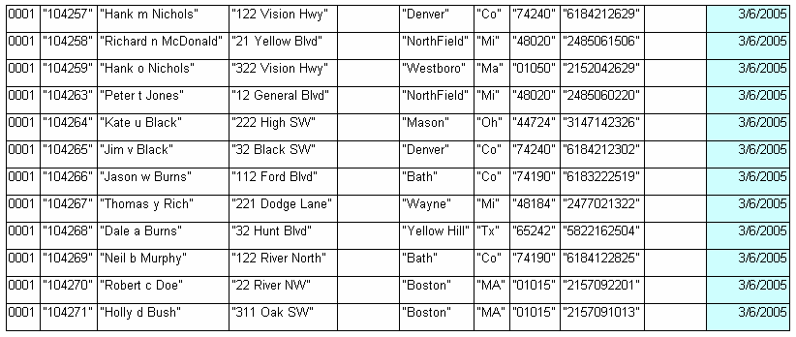
Convert:
Date Format - 1
Date Format - 2
Converted Date Format

Slide 58
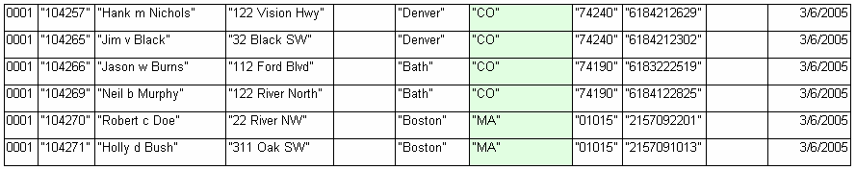
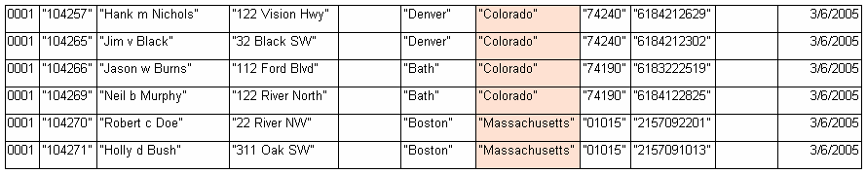
Translate:
Translated Rows

Slide 59
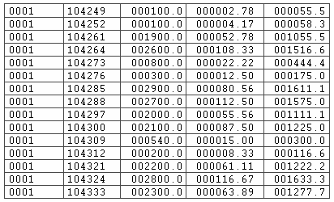
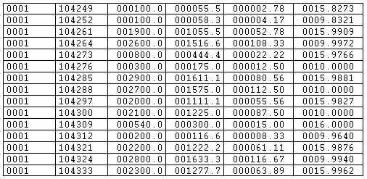
Derive:
Input
(ORIG_LOAN – BALANCE) / PAYMENT_AMT
Derived Output

Slide 60
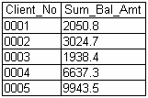
Summarize:
Summarized Rows

Slide 61
Exercises – 8, 9, 10 & 11:
Using Transformation Stages: Part-1,
Using Transformation Stages: Part-2,
Using Transformation Stages: Part-3
&
Using Transformation Stages: Part-4

Slide 62
Rejecting Data:
Reject option on sequential stage:
  Data does not agree with meta data
  Output consists of one column with binary data type
Reject links (from Lookup stage) result from the drop option of the property "If Not Found":
  Lookup "failed"
  All columns on reject link (no column mapping option)
Reject constraints are controlled from the constraint editor of the transformer:
  Can control column mapping
  Use the "Other/Log" checkbox

Slide 63
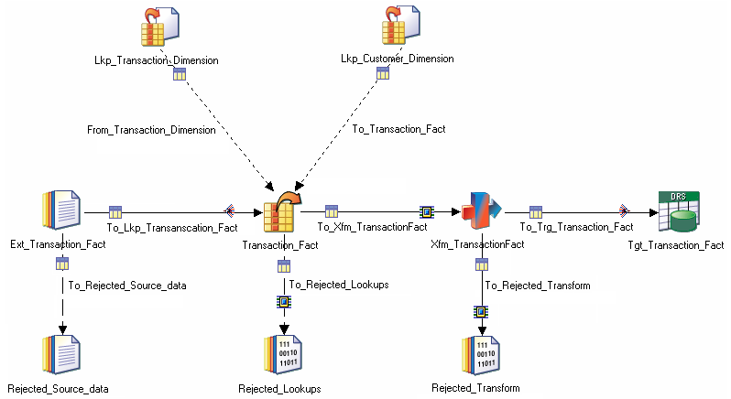
Reject Handling:
Property Reject Mode = Output
"If Not Found" property
Constraint – Other/log option

Slide 64
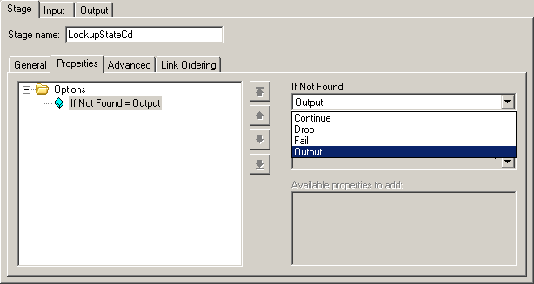
Lookup Reject Link:
"Output" option automatically creates the reject link
Notes:
All columns from the input link will be placed on the rejects link. Therefore, no column tab is available for the rejects link.

Slide 65
Exercise - 12:
Reject Handling.

Slide 66
Transformation Stages:
Transformer
Aggregator
Filter
Funnel
Lookup
Join
Merge
Sort
RemDup

Slide 67
Loading Stages:
Database Stages
  DB2/UDB Enterprise
  Oracle Enterprise
  Teradata Enterprise
  Sybase
  Informix Enterprise

Slide 68
DBMS as Target:
Write Methods
  Delete
  Load
  Upsert
  Write (DB2)
Write mode for load method
  Truncate
  Create
  Replace
  Append

Slide 69
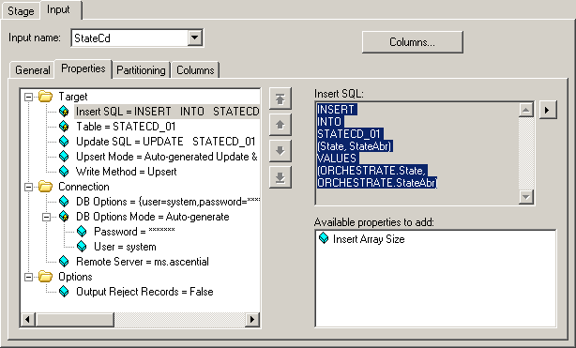
Target Properties:
Generated code can be copied
Upsert mode determines options

Slide 70

Customizing EE:
Three possible options:
Wrappers
Buildops
Custom Stages

Slide 71
Exercise-13:
Creating Buildop stages and using it.

Slide 72
Scheduling:
Job Sequencer
Restart / Recovery
Email notification

Slide 73
Sequences:
Job Sequencer now supports:
  Checkpoint/Restart
  Looping
  Expression Support
  User Variables Stage
  Automatically Handling Aborts
  Terminator Stage ~ aborting a sequence
  Enhanced Variable Support
  Enhancements to other activity stages:
    WaitForFile Stage
    Notify Stage
Continued …

Slide 74
Checkpoint/re-start mechanism for Sequences:
  Set/unset via a job property
    Compiler generates different code.
If a job fails within a sequence, the sequence can be restarted and will skip to the pointing of failure before starting execution:
    Successfully run jobs are not restarted
    Failed (aborted) jobs are reset & run
    Activities occurring beyond the original point of failure are run when sequence reaches them.
If a sequence is in the "Aborted / Restartable" state:
    "Run" will restart it from the checkpoint
    "Reset" will clear the checkpoint information so the next "Run" will start the entire sequence again
    Recompiling the sequence clears checkpoint information too

Slide 75
Checkpoints:
Checkpointing must be enabled at design time:
  Project wide setting to enable checkpointing in all new sequences.
  Job level property to override the project setting for a given sequence.
  Activity (stage) level property to allow disabling of checkpointing for a specific job run or activity (routine, command etc.) within a sequence.

Slide 76
Method of execution:
“When SEQUENCE runs:
JOB1 – fails
JOB1 – OK, JOB2 – fails
JOB1 – OK, JOB2 – OK
JOB3 – fails
JOB1 – OK, JOB2 – OK
JOB3 – OK
When SEQUENCE is restarted:
Reset JOB1 and run it again
Skip JOB1, reset JOB2 and run it again
Skip JOB1 & JOB2, reset JOB3 and run it again
Start at JOB1 again.

Slide 77
Exercise – 14:
Job Sequencing

Slide 78
Standard Parameter Management:
Job Parameters.
Sequence.
Environment variables.
Encrypted environment variables.

Slide 79

A sequence of two jobs FileSet and DataSet.

Slide 80
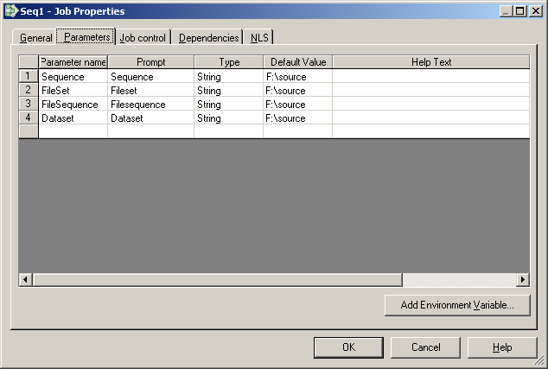
Job Properties:

Slide 81
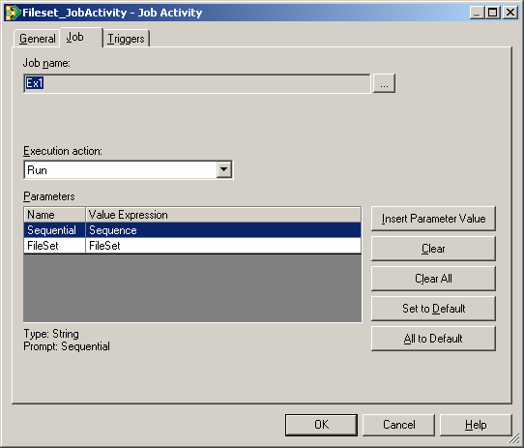
Enter the value expression using Insert Parameter Value:

Slide 82

Job Sequencer – User Variables:

Slide 83
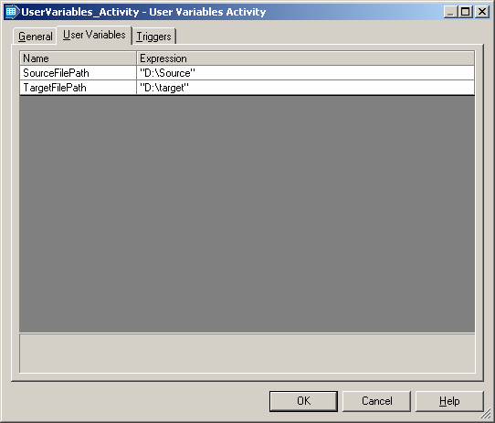
Activity:

Slide 84
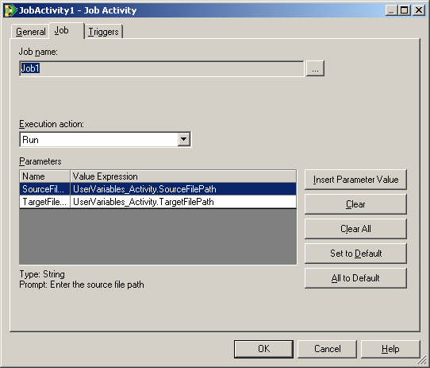
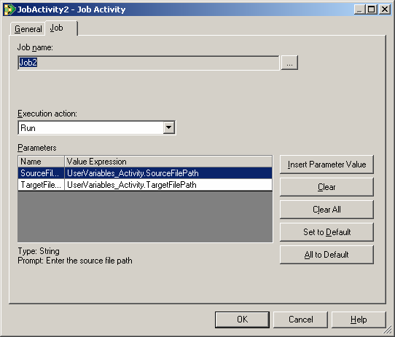
Job-1 Activity
Job-2 Activity

Slide 85
Run Time Message Handling:
Runtime Message Customization:
  Allows the user to customize how runtime messages are handled in DataStage
  Based on definition of "Message Handlers"
    Specify the action to be taken if a particular message is generated
    Customization is based on the message ID
  Three customization actions are supported:
    Suppress message [Informational & Warning messages only]
    Demote message [from Warning to Informational]
    Promote message [from Informational to Warning]
Message Handlers can be applied to whole projects or to individual jobs.
A Message Handler is a named file containing the customization rules.

Slide 86
To define a Message Handler:
  From Director log view, select the message to handle and then select "Job -> Add rule to message handler…" menu option or right-click & select "Add rule to message handler…" on the context menu.
  Message can be added to a specific message handler file, a project handler or local handler for this job.
  Action is dependent on message type.
Types of Message Handlers:
  Local runtime message handler
    Applies to the current job, and takes effect next time the job is run.
    Set in Job Properties->Defaults tab
    Gets compiled into the job and is exported with the executable
    Applied before any project level handler
Project Message Handler:
  A message Handler file, which is associated with the current project.
  Set in the Administrator client on the Project Properties -> Parallel Tab.
  The combination of the two levels (both optional) defines the message handling for a given job.

Slide 87
Managing Message Handler:
  A management tools enables the user to Create, View, Edit and Delete message handler files.
  Available from a "Message Handlers" option on the Manager and Director Tools menus for Parallel enabled projects only.
Managing Handler Manager:
  Displays handler rules in either the local runtime handler, the project handler or the selected handler.
  Rules can be edited * the handler saved (overwriting or "as new").

Slide 88
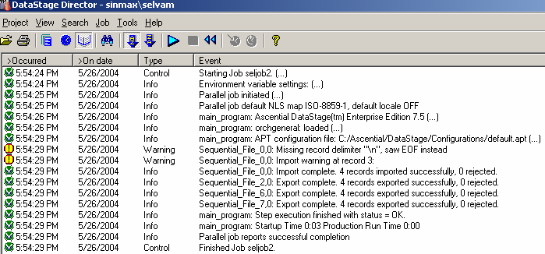
Message Handlers:

Slide 89

Director > Job > Add rule to message handler

Slide 90

Click previous till message text appears, select the action to be done:

Slide 91

Click Add Rule and click OK:

Slide 92

Close and run the job View the log file:

Slide 93

Creating new message handler:
Director > Tools > Message Handler Management

Slide 94

Click New and click Save Enter a name:

Slide 95

Designer > View > JobProperties > Defaults > select the name given:

Slide 96

Open Add rule to message handler:
Select Add rule to message handler
Select the given name from message handler
Click Add rule
Click OK, Close
Compile and run the job

Slide 97

View director log:

Slide 98

Handling Exceptions (Automatic):
Triggers "Executed OK"
Automatically aborts when an error is detected.
What happen to Warnings?
Notes:
Note: How automatic exception handler works with routines and jobs.
Note: warnings are not considered errors by Automatic handler.
It is important to not let warnings go unattended.
Options:
1. Run jobs with warning threshold as 1. (DS nicely passes this to all child jobs it runs)
2. Review job logs (write audit report)
Routine Activities return stageName.$ReturnValue
Value is set from Return(Ans) in routine.
When Compiled with automatic handler a non zero $ReturnValue is treated as an error. The compiler generates code similar to this:
If (r$V0S8 <> 0) Then
msg$ = DSMakeMsg("DSTAGE_JSG_M_0042\Unhandled failure (%1) encountered calling routine %2", r$V0S8:@FM:"DSX.UTILITYMESSAGETOLOG")
msg$id = "@Routine1"; Goto L$ERROR
End
Job Activities return JobActivityName.$JobStatus
Value is obtained from Call to DSGetJobInfo.
Possible return values of CALL to DSGetJobInfo for token DSJ.STATUS:
(Table was taken from the JOBCONTROL.H file found in all DataStage projects)
DSJS.RUNNING = 0 ;* This is the only status that means the job is actually running
DSJS.RUNOK = 1 ;* Job finished a normal run with no warnings
DSJS.RUNWARN = 2 ;* Job finished a normal run with warnings
DSJS.RUNFAILED = 3 ;* Job finished a normal run with a fatal error
DSJS.VALOK = 11 ;* Job finished a validation run with no warnings
DSJS.VALWARN = 12 ;* Job finished a validation run with warnings
DSJS.VALFAILED = 13 ;* Job failed a validation run
DSJS.RESET = 21 ;* Job finished a reset run
DSJS.CRASHED = 96 ;* Job has crashed
DSJS.STOPPED = 97 ;* Job was stopped by operator intervention (can't tell run type)
DSJS.NOTRUNNABLE = 98 ;* Job has not been compiled
DSJS.NOTRUNNING = 99 ;* Any other status
Automatically handle activates that fail.
Activities that fail are jobs and Routines.
A job fails when %.$JobsStatus <> DSJS.RUNOK And %.JobStatus <> DSJS.RUNWARN)

Slide 99

Handling Exceptions with Triggers:
Notes:
Demonstrates behaviors as a result of setting different Trigger Types.
Routine activity = a return value of zero is considered an excepution.

Slide 100

Handling Exceptions (Best Practice):
Warnings are Explicitly Handled
Or
Set Warning Threshold to 1
Automatic Exception Handler
Uses variabels:
$ErrSource
$ErrNumber
$ErrMessage
Control Parallel Streams

Slide 101
Other Sequence Activities:

Slide 102

Nested Condition:

Slide 103


Condition:
Activity:

Slide 104

Log file:

Slide 105

Debugging Changes:
Debugging helpers:
  Option to append row number and file name to row being processed, option to read only (n) number of rows and first line is columns names.

Slide 106
Routine Activities for Unlimited Flexibility:
Combine repetitive operations.
Reuse.
More parameter control.
Take advantage of graph walking:
  Checkpoint
  Sub flow selection
  Return status of flow

Slide 107

Routine Activity Stage :
Routine - DSJobReport :

Slide 108

Routine – DSSendMail :

Slide 109

E-Mail Notification Property :

Slide 110


Slide 111

Step – 1:
ExecDOS Routine :

Slide 112

Step – 2:

Slide 113

Log Display:

Slide 114

Step – 1:
ExecTCL Routine :

Slide 115

Step – 2:

Slide 116

Log Display:

Slide 117


ExecSH :
ExecSHSilent :

Slide 118


ExecSH Property :
ExecSHSilent Property:

Slide 119


ExecSHSilent Log:
ExecSH Log :

Slide 120
Job Sequencer – Terminator Stage:
Easy way to abort a sequence cleanly:
  Optionally send STOPs to all running jobs
  Optionally wait for all jobs to finish
  Log final abort message
Can have any number of these in different branches of a sequence:
  Only one will get executed of course…

Slide 121

Terminator Activity :
A terminator stage can be placed in a job sequence to ensure that the sequence is stopped cleanly if certain situations arise. You can have multiple terminator activities and can place them anywhere in the sequence. They are connected to other stages by triggers, which specify when a terminator will be invoked.

Slide 122

Property :

Slide 123

Example job :

Slide 124
DataStage EE Architecture
In depth

Slide 125
Objectives:
Understand how Enterprise Edition Framework processes data
You will be able to:
  Read and understand OSH
  Perform troubleshooting

Slide 126
Concepts:
The Enterprise Edition Platform:
  Script language - OSH (generated by DataStage Parallel Canvas, and run by DataStage Director)
  Communication - Conductor, Section Leaders, Players.
  Configuration files (only one active at a time, describes H/W)
  Meta data - schemas/tables
  Schema propagation – RCP
  EE extensibility - Buildop, Wrapper
  Datasets (data in Framework's internal representation)

Slide 127
DS-EE Stage Elements:
EE Stages Involve A Series Of Processing Steps
Input Data Set schema:
prov_num:int16;
member_num:int8;
custid:int32;
Output Data Set schema:
prov_num:int16;
member_num:int8;
custid:int32;
Input
Interface
Business Logic
Output Interface
Partitioner
EE Stage
Piece of Application Logic Running Against Individual Records.
Parallel or Sequential.
Notes:
Each stage has input and output interface schemas, a partitioner and business logic.
Interface schemas define the names and data types of the required fields of the component’s input and output Data Sets. The component’s input interface schema requires that an input Data Set have the named fields and data types exactly compatible with those specified by the interface schema for the input Data Set to be accepted by the component.
A component ignores any extra fields in a Data Set, which allows the component to be used with any data set that has at least the input interface schema of the component. This property makes it possible to add and delete fields from a relational database table or from the Orchestrate Data Set without having to rewrite code inside the component.
In the example shown here, Component has an interface schema that requires three fields with named fields and data types as shown in the example. In this example, the output schema for the component is the same as the input schema. This does not always have to be the case.
The partitioner is key to Orchestrate’s ability to deliver parallelism and unlimited scalability. We’ll discuss exactly how the partitioners work in a few slides, but here it’s important to point out that partitioners are an integral part of Orchestrate components.

Slide 128
DSEE Stage Execution:
Dual Parallelism Eliminates Bottlenecks!
EE Delivers Parallelism in Two Ways
  Pipeline
  Partition
Block Buffering Between Components
  Eliminates Need for Program Load Balancing
  Maintains Orderly Data Flow
Producer
Pipeline
Consumer
Partition
Notes:
There is one more point to be made about the DSEE execution model.
DSEE achieves parallelism in two ways. We have already talked about partitioning the records and running multiple instances of each component to speed up program execution. In addition to this partition parallelism, Orchestrate is also executing pipeline parallelism.
As shown in the picture on the left, as the Orchestrate program is executing, a producer component is feeding records to a consumer component without first writing the records to disk. Orchestrate is pipelining the records forward in the flow as they are being processed by each component. This means that the consumer component is processing records fed to it by the producer component before the producer has finished processing all of the records.
Orchestrate provides block buffering between components so that producers cannot produce records faster than consumers can consume those records.
This pipelining of records eliminates the need to store intermediate results to disk, which can provide significant performance advantages, particularly when operating against large volumes of data.

Slide 129
Stages Control Partition Parallelism:
Execution Mode (sequential/parallel) is controlled by Stage
  default = parallel for most Ascential-supplied Stages
  Developer can override default mode
  Parallel Stage inserts the default partitioner (Auto) on its input links
  Sequential Stage inserts the default collector (Auto) on its input links
  Developer can override default
    execution mode (parallel/sequential) of Stage > Advanced tab
    choice of partitioner/collector on Input > Partitioning tab

Slide 130
How Parallel Is It?
Degree of parallelism is determined by the configuration file
  Total number of logical nodes in default pool, or a subset if using "constraints".
    Constraints are assigned to specific pools as defined in configuration file and can be referenced in the stage.

Slide 131
Configuration Files:

Slide 132
Objectives:
Understand how DataStage EE uses configuration files to determine parallel behavior.
Use this understanding to:
  Build a EE configuration file for a computer system.
  Change node configurations to support adding resources to processes that need them.
  Create a job that will change resource allocations at the stage level.

Slide 133
Configuration File Concepts:
Determine the processing nodes and disk space connected to each node.
When system changes, need only change the configuration file – no need to recompile jobs.
When DataStage job runs, platform reads configuration file
  Platform automatically scales the application to fit the system.

Slide 134
Processing Nodes Are:
Locations on which the framework runs applications.
Logical rather than physical construct.
Do not necessarily correspond to the number of CPUs in your system.
  Typically one node for two CPUs.
Can define one processing node for multiple physical nodes or multiple processing nodes for one physical node.

Slide 135
Optimizing Parallelism:
Degree of parallelism determined by number of nodes defined.
Parallelism should be optimized, not maximized
  Increasing parallelism distributes work load but also increases Framework overhead.
Hardware influences degree of parallelism possible.
System hardware partially determines configuration.
Notes:
The hardware that makes up your system partially determines configuration. For example, applications with large memory requirements, such as sort operations, are best assigned to machines with a lot of memory. Applications that will access an RDBMS must run on its server nodes; operators using other proprietary software, such as SAS or SyncSort, must run on nodes with licenses for that software.

Slide 136
More Factors to Consider:
Communication amongst operators:
  Should be optimized by your configuration.
  Operators exchanging large amounts of data should be assigned to nodes communicating by shared memory or high-speed link.
SMP – leave some processors for operating system.
Desirable to equalize partitioning of data.
Use an experimental approach:
  Start with small data sets.
  Try different parallelism while scaling up data set sizes.

Slide 137
Factors Affecting Optimal Degree of Parallelism:
CPU intensive applications:
  Benefit from the greatest possible parallelism.
Applications that are disk intensive:
  Number of logical nodes equals the number of disk spindles being accessed.

Slide 138
Configuration File:
Text file containing string data that is passed to the Framework
  Sits on server side
  Can be displayed and edited
Name and location found in environmental variable APT_CONFIG_FILE
Components
  Node
  Fast name
  Pools
  Resource

Slide 139
Node Options:
Node name – name of a processing node used by EE:
  Typically the network name
  Use command uname –n to obtain network name
Fastname:
  Name of node as referred to by fastest network in the system
  Operators use physical node name to open connections
  NOTE: for SMP, all CPUs share single connection to network
Pools:
  Names of pools to which this node is assigned
  Used to logically group nodes
  Can also be used to group resources
Resource:
  Disk
  Scratchdisk
Notes:
Set of node pool reserved names:
DB2
Oracle
Informix
Sas
Sort
Syncsort

Slide 140
Sample Configuration File:
{
node "Node1"
{
fastname "BlackHole"
pools "" "node1"
resource disk "/usr/dsadm/Ascential/DataStage/Datasets" {pools "" }
resource scratchdisk "/usr/dsadm/Ascential/DataStage/Scratch" {pools "" }
}
}
Notes:
For a single node system node name usually set to value of UNIX command –uname –n
Fastname attribute is the name of the node as it is referred to on the fastest network in the system, such as an IBM switch, FDDI, or BYNET.
The fast name is the physical node name that operators use to open connections for high-volume data transfers. Typically this is the principal node name as returned by the UNIX command uname –n.

Slide 141
The Configuration File:
CPU
CPU
CPU
CPU
An SMP
A Cluster
CPU
CPU
CPU
CPU
Ethernet or High-speed network
{
node "node0" {
fastname "node0_byn"
pools "" "node0" "node0_fddi"
resource disk "/dsee/s0" { }
resource disk "/dsee/s1" { }
resource scratchdisk "/scratch" { }
}
node "node1" {
fastname "node0_byn"
pools "" "node1" "node1_fddi"
resource disk "/dsee/s0" { }
resource disk "/dsee/s1" { }
resource scratchdisk "/scratch" { }
}
}
{
node "node0" {
fastname "node0_css"
pools "" "node0" "node0_fddi"
resource disk "/dsee/s0" { }
resource scratchdisk "/scratch" { }
}
node "node1" {
fastname "node1_css"
pools "" "node1" "node1_fddi"
resource disk "/dsee/s0" { }
resource scratchdisk "/scratch" { }
}
}
No change in Application. Just a Config File change.

Slide 142
Disk Pools:
Pool "bigdata"
Disk pools allocate storage
By default, EE uses the default pool, specified by ""

Slide 143
Sorting Requirements:
Resource pools can also be specified for sorting:
The Sort stage looks first for scratch disk resources in a "sort" pool, and then in the default disk pool.
Notes:
Recommendations:
Each logical node defined in the configuration file that will run sorting operations should have its own sort disk.
Each logical node's sorting disk should be a distinct disk drive or a striped disk, if it is shared among nodes.
In large sorting operations, each node that performs sorting should have multiple disks, where a sort disk is a scratch disk available for sorting that resides in either the sort or default disk pool.

Slide 144
Another Configuration File Example:
{
node "n1" {
fastname “s1"
pool "" "n1" "s1" "sort"
resource disk "/data/n1/d1" {}
resource disk "/data/n1/d2" {}
resource scratchdisk "/scratch" {"sort"}
}
node "n2" {
fastname "s2"
pool "" "n2" "s2" "app1"
resource disk "/data/n2/d1" {}
resource scratchdisk "/scratch" {}
}
node "n3" {
fastname "s3"
pool "" "n3" "s3" "app1"
resource disk "/data/n3/d1" {}
resource scratchdisk "/scratch" {}
}
node "n4" {
fastname "s4"
pool "" "n4" "s4" "app1"
resource disk "/data/n4/d1" {}
resource scratchdisk "/scratch" {}
}
...
}
6
4
5
2
3
1

Slide 145
Resource Types:
Disk
Scratchdisk
DB2
Oracle
Saswork
Sortwork
Can exist in a pool
  Groups resources together

Slide 146


Using Different Configurations:
Lookup stage where DBMS is using a sparse lookup type
Notes:
In this instance, since a sparse lookup is viewed as the bottleneck, the stage has been set to execute on multiple nodes.

Slide 147
Building a Configuration File:
Scoping the hardware:
  Is the hardware configuration SMP, Cluster, or MPP?
  Define each node structure (an SMP would be single node):
    Number of CPUs
    CPU speed
    Available memory
    Available page/swap space
    Connectivity (network/back-panel speed)
  Is the machine dedicated to EE? If not, what other applications are running on it?
  Get a breakdown of the resource usage (vmstat, mpstat, iostat)
  Are there other configuration restrictions? E.g. DB only runs on certain nodes and ETL cannot run on them?

Slide 148
Working with Configuration Files:
You can easily switch between config files:
    '1-node' file - for sequential execution, lighter reports—handy for testing
    'MedN-nodes' file - aims at a mix of pipeline and data-partitioned parallelism
    'BigN-nodes' file - aims at full data-partitioned parallelism
Only one file is active while a step is running
    The Framework queries (first) the environment variable:
$APT_CONFIG_FILE
# nodes declared in the config file needs not match # CPUs
    Same configuration file can be used in development and target machines.

Slide 149

Scheduling Nodes, Processes, and CPUs:
DS/EE does not:
  know how many CPUs are available
  schedule
Who knows what?
Who does what?
  DS/EE creates (Nodes*Ops) Unix processes
  The O/S schedules these processes on the CPUs
Nodes = # logical nodes declared in config. file
Ops = # ops. (approx. # blue boxes in V.O.)
Processes = # Unix processes
CPUs = # available CPUs

Slide 150
Configuring DSEE – Node Pools:
{
node "n1" {
fastname "s1"
pool "" "n1" "s1" "app2" "sort"
resource disk "/orch/n1/d1" {}
resource disk "/orch/n1/d2" {}
resource scratchdisk "/temp" {"sort"}
}
node "n2" {
fastname "s2"
pool "" "n2" "s2" "app1"
resource disk "/orch/n2/d1" {}
resource disk "/orch/n2/d2" {}
resource scratchdisk "/temp" {}
}
node "n3" {
fastname "s3"
pool "" "n3" "s3" "app1"
resource disk "/orch/n3/d1" {}
resource scratchdisk "/temp" {}
}
node "n4" {
fastname "s4"
pool "" "n4" "s4" "app1"
resource disk "/orch/n4/d1" {}
resource scratchdisk "/temp" {}
}
3
4
1
2

Slide 151
Configuring DSEE – Disk Pools:
{
node "n1" {
fastname "s1"
pool "" "n1" "s1" "app2" "sort"
resource disk "/orch/n1/d1" {}
resource disk "/orch/n1/d2" {"bigdata"}
resource scratchdisk "/temp" {"sort"}
}
node "n2" {
fastname "s2"
pool "" "n2" "s2" "app1"
resource disk "/orch/n2/d1" {}
resource disk "/orch/n2/d2" {"bigdata"}
resource scratchdisk "/temp" {}
}
node "n3" {
fastname "s3"
pool "" "n3" "s3" "app1"
resource disk "/orch/n3/d1" {}
resource scratchdisk "/temp" {}
}
node "n4" {
fastname "s4"
pool "" "n4" "s4" "app1"
resource disk "/orch/n4/d1" {}
resource scratchdisk "/temp" {}
}
3
4
1
2

Slide 152
Re-Partitioning:
Parallel to parallel flow may incur reshuffling:
Records may jump between nodes
node 1
node 2
partitioner

Slide 153
OSH:
DataStage EE GUI generates OSH scripts
  Ability to view OSH turned on in Administrator
  OSH can be viewed in Designer using job properties
The Framework executes OSH.
What is OSH?
  Orchestrate shell
  Has a UNIX command-line interface

Slide 154
OSH Script:
An OSH script is a quoted string which specifies:
  The operators and connections of a single Orchestrate step
  In its simplest form, it is:
      OSH "op < in.ds > out.ds"
Where:
  op is an Orchestrate operator
  in.ds is the input data set
  out.ds is the output data set

Slide 155
OSH Operators:
OSH Operator is an instance of a C++ class inheriting from APT_Operator.
Developers can create new operators.
Examples of existing operators:
  Import
  Export
  RemoveDups
Notes:
Operators are the basic functional units of an Orchestrate application. Operators
read records from input data sets, perform actions on the input records, and write
results to output data sets. An operator may perform an action as simple as
copying records from an input data set to an output data set without
modification. Alternatively, an operator may modify a record by adding,
removing, or modifying fields during execution.
Operators are the basic functional units of an Orchestrate application. Operators
read records from input data sets, perform actions on the input records, and write
results to output data sets. An operator may perform an action as simple as
copying records from an input data set to an output data set without
modification. Alternatively, an operator may modify a record by adding,
removing, or modifying fields during execution.
Operators are the basic functional units of an Orchestrate application. Operators read records from input data sets, perform actions on the input records, and write results to output data sets. An operator may perform an action as simple as copying records from an input data set to an output data set without modification. Alternatively, an operator may modify a record by adding,
removing, or modifying fields during execution.

Slide 156

Enable Visible OSH in Administrator:
Will be enabled for all projects

Slide 157

View OSH in Designer:
Operator
Schema

Slide 158
Job Execution - Orchestrate:
Conductor - initial DS/EE process
  Step Composer
  Creates Section Leader processes (one/node)
  Consolidates massages, outputs them
  Manages orderly shutdown.
Section Leader
  Forks Players processes (one/Stage)
  Manages up/down communication.
Players
  The actual processes associated with Stages
  Combined players: one process only
  Send stderr to SL
  Establish connections to other players for data flow
  Clean up upon completion.
Conductor Node
C
Processing Node
SL
P
P
P
Processing Node
SL
P
P
P
Communication:
    SMP: Shared Memory
    MPP: TCP

Slide 159
Partitioning:

Slide 160
Partitioning Methods:
Auto
Hash
Entire
Range

Slide 161
Collectors:
Collectors combine partitions of a dataset into a single input stream to a sequential Stage.
…
Data Partitions
Collector
Sequential Stage
Collectors do NOT synchronize data.

Slide 162

Partitioning and Repartitioning Visible on Job Design:
Partitioner
Collector

Slide 163

Partitioning and Collecting Icons:
Partitioner
Collector

Slide 164

Setting a Node Constraint in the GUI:

Slide 165
Troubleshooting:
Debug using Peek stage
Logs (Warnings / Messages)
Message handler
Environment Variables

Slide 166
Reading Messages in Director:
Set APT_DUMP_SCORE to true.
Can be specified as job parameter.
Messages sent to Director log.
If set, parallel job will produce a report showing the operators, processes, and datasets in the running job.

Slide 167

Messages With APT_DUMP_SCORE = True:

Slide 168
Environment Variables For All Jobs:
The following environment variables are recommended for all jobs. Although these can be set at the project level, it is better to specify within job properties
  Provides runtime parameter
  Specify in your Job template(s)
$APT_CONFIG_FILE=[filepath]
$APT_DUMP_SCORE=1 [True]
$APT_RECORD_COUNTS=1
  Outputs record counts to the job log as each operator completes processing
$APT_STARTUP_STATUS
$APT_PM_SHOW_PIDS=1 [True]
  Places UNIX process ID entries in job log for each process started at runtime
  Does not show DataStage phantom or Server processes

Slide 169
Job Debugging Environment Variables:
The following environment variables can assist with debugging a job flow:
  $OSH_PRINT_SCHEMAS=1
    Outputs the actual schema used at runtime for each dataset in a job flow. This is useful for determining if actual schema matches what the job designer expected.
  $APT_PM_PLAYER_TIMING=1
    When set, prints detailed information in the job log for each operator, including CPU utilization and elapsed processing time.
  $APT_PM_PLAYER_MEMORY=1
    When set, prints detailed information in the job log for each operator when additional memory is allocated.

Slide 170
    $APT_BUFFERING_POLICY=FORCE
    $APT_BUFFER_FREE_RUN=1000
      Used in conjunction, these two environment variables effectively isolate each operator from slowing upstream production. Using the job monitor statistics, this can identify which part of a job flow is impacting overall performance.
      NOT recommended for production job runs!

Slide 171

Change Apply Stage :
Definition : Takes the change data set, that contains the changes in the before and after data sets, from the Change Capture stage and applies the encoded change operations to a before data set to compute an after data set.
The Change Apply stage read a record from the change data set and from the before data set, compares their key column values, and acts accordingly.

Slide 172


Change Capture Property :
Change Apply Property :

Slide 173




Input (Before Changes) :
Output :
Input (After Changes) :

Slide 174

Job :

Slide 175

Compress Stage :
The Compress stage uses the UNIX compress or GZIP utility to compress a data set. It converts a data set from a sequence of records into a stream of raw binary data.

Slide 176


Steps :
Set the Stage Properties : "Command = Compress"
Load the Metadata in the Output tab…

Slide 177

Example :
Limitations :
A compressed data set cannot be processed by many stages until it is expanded, i.e., until its rows are returned to their normal format. Stages that do not perform column based processing or reorder the rows can operate on compressed data sets. For example, you can use the copy stage to create a copy of the compressed data set.

Slide 178

Expand Stage :
The Expand stage uses the UNIX compress or GZIP utility to expand the data set. It converts a data set from a stream of raw binary data into sequence of records.

Slide 179

Steps :
Set the Stage Properties : "Command = Uncompress"
Load the Metadata in the Output tab…

Slide 180

Example Job :

Slide 181

Surrogate Key Generator Stage:
Definition : The Surrogate Key stage generates key columns for an existing data set.
User can specify certain characteristics of the key sequence. The stage generates sequentially incrementing unique integers from a given starting point. The existing columns of the data set are passed straight through the stage.
If the stage is operating in parallel, each node will increment the key by the number of partitions being written to.

Slide 182

Job (before execution):

Slide 183



Input :
Property :
Output :

Slide 184

Job (after execution):

Slide 185

Switch Stage :
Definition : The switch stage takes a single data set as input and assigns each input row to an output data set based on the value of a selector field.
It can have a single input link, up to 128 output links and a single rejects link. This stage performs an operation similar to a C switch statement. Rows that satisfy none of the cases are output on the rejects link.

Slide 186

Property:
when Selector Mode = Auto

Slide 187





Output - 1 :
Input :
Output - 2 :
Reject :
Output - 3 :

Slide 188

Job (after execution):

Slide 189

Property :
when Selector Mode = Hash

Slide 190


Output - 1 :
Input :
Output - 2 :
Output - 3 :

Slide 191

Job (after execution):

Slide 192

Property :
when Selector Mode = User Defined Mapping

Slide 193


Output - 1 :
Input :
Output - 2 :
Reject :
Output - 3 :

Slide 194

Job (after execution):

Slide 195

Modify Stage:
Definition : The Modify stage alters the record schema of its input data set. The modified data set is then output. It is a processing stage.
It can have a single input and single output.

Slide 196

Null Handling:
Null Handling:
Job (before handling):

Slide 197




Step – 1:
"NULL" value has to be handled…

Slide 198




Null Handling
Step – 2:
Syntax : Column_Name=Handle_Null('Column_Name',Value)
Input Link Columns
Output Link Columns

Slide 199




Step – 3:
"NULL" value has been handled…

Slide 200

Job (after execution):

Slide 201
Drop Column(s):
Drop Column(s):
Job (before execution):

Slide 202

Step – 1:
The column "MGR" has to be dropped…

Slide 203


Dropping Column
Step – 2:
Syntax : DROP Column_Name
Input Link Columns
Output Link Columns

Slide 204

Step – 3:
The column "MGR" has been dropped…

Slide 205
Job (after execution):

Slide 206
Keep Column(s):
Keep Column(s):
Job (before execution):

Slide 207


Step – 1:
The column "EmpNo" has to be kept…

Slide 208

Keeping Column
Step – 2:
Syntax : KEEP Column_Name
Input Link Columns
Output Link Columns

Slide 209

Step – 3:
The column "EmpNo" is kept…

Slide 210
Job (after execution):

Slide 211
Type Conversion:
Type Conversion:
Job (before execution):

Slide 212


Step – 1:
The column "HireDate" has to converted to Date…

Slide 213



Type Conversion
Step – 2:
Syntax : Column_Name=type_conversion('Column_Name')
Input Link Columns
Output Link Columns

Slide 214


Step – 3:
The column "HireDate" has been converted to Date…

Slide 215
Job (after execution):

Slide 216
Multiple Specifications:
Multiple Specifications:
Job (before execution):

Slide 217


Step – 1:
The column "HireDate" has to converted to Date…
The column "MGR" has to be Null handled…

Slide 218



Null Handling
Step – 2:
Type Conversion
Input Link Columns
Output Link Columns

Slide 219

Step – 3:
The column "HireDate" has been converted to Date…
The column "MGR" has been Null handled…

Slide 220
Job (after execution):

Slide 221

Pivot Stage :
Pivot Stage converts columns in to rows.
Eg., Mark-1 and Mark-2 are two columns.
Task : Convert all the columns in to one column.
Implication : Can be used to co SCD Type-3 to Type-2.
Using Methodology : In the deviation field of the output column change the input columns in to one column.
Eg., Column Name – "Marks".
Derivation : Mark-1 and Mark-2.
Note : Column "Marks" is derived from the input columns Mark-1 and Mark-2.

Slide 222

Job (before execution):

Slide 223



Input metadata:
Source File:
Output Metadata:
Note the change in the derivation …

Slide 224


Job (after execution) :
Output file:

Slide 225

Merge Stage :
Definition : Join Stage combines a sorted master data set with one or more update data sets. The columns from the records in the master and update data sets are merged so that the output record contains all the columns from the master record plus any additional columns from each update record.
A master record and an update record are merged only if both of them have the same values for the merge key column(s) that you specify. Merge key columns are one or more columns that exist in both the master and update records.
The data sets input to the Merge stage must be key partitioned and sorted. This ensures that rows with the same key column values are located in the same partition and will be processed by the same node.

Slide 226


Unmatched Masters Mode = Drop
Job :

Slide 227




Master :
Output :
Updates :
Reject :

Slide 228


Unmatched Masters Mode = Keep
Job :

Slide 229

Master :
Output :
Updates :
Reject :

Slide 230


Note : If the options "Warn on Reject Updates = True" and "Warn on Unmatched Masters = True" then the log file shows the warnings on Reject Updates and Unmatched Data from Masters.

Slide 231


Note : If the options "Warn on Reject Updates = False" and "Warn on Unmatched Masters = False" then the log file do not shows the warnings on Reject Updates and Unmatched Data from Masters.

Slide 232
Development Standards:
  Job parameters
  Job documentation
  Job naming conventions
  Stage and Link naming conventions
  Using configuration files

Slide 233
Best Practices:
  Ideal Job design – strike a balance:
  Modular job design:
  Achieving Performance:
    Choosing the right Partition method
    Using right stage for the right job
    Right decision – SQL or DataStage ?
    Multiple Physical disks

Slide 234
Developer Best Practices:
Multi node Import:
Multi-node import enables different physical nodes to read the same flat file during import.
  Eliminates the I/O contention on a file and thus can improve job performance.
Lookup Fileset:
When creating a Lookup File Set, if a reference key column is going to be used in a lookup condition or propagated to the lookup output, then this key column should have its new "Keep" sub-option set to true.
Having the "Keep" option set to True for unused keys will have an unnecessary performance overhead (it defaults to False).

Slide 235
Unlike Server, Enterprise Edition engine enforces metadata
  Developer must pay attention to data types, nullability, etc.
  Built-in default type conversions are used by stage mappings.
  MAJOR benefits at runtime – fewer data consistency issues.

Slide 236

For optimum performance, consider more appropriate stages instead of a Transformer in parallel job flows:
  Use the Copy stage as a placeholder
    this is different from DataStage Server!
    unless FORCE=TRUE, Copy is optimized out at runtime
  Leverage Output Mappings (RCP off) across a stage to
    Rename Columns
    Drop Columns
    Perform Default Type Conversions (see 7.5 Advanced Parallel Job Developers Guide)

Slide 237

  Modify is the most efficient "stage". Use it for
    Non-default type conversions
    Null handling (converting between in-band and out-of-band)
    String trimming (v7.01 and later)
  For best performance, avoid use of the BASIC transformer.

Slide 238

More Transformer Best Practices:
Always include Reject Link
  Captures NULL errors from Transformer expressions
Always test for null value before using a column in an expression
Minimize type conversions
Be aware of Column and Stage Variable data types

Slide 239
Job Design:
Ideal job design must strike a balance between performance, resource usage, and restartability
In theory, best performance results from processing all data in-memory without landing to disk
  Requires hardware resources (eg. CPU, memory) and O/S resources (eg. ulimit, nfiles, etc)
    Resource usage grows exponentially based on degree of parallelism and number of stages in a flow
    Must also consider what else is running on the server(s)
  May not be possible with very large amounts of data
    Example: Sort will use scratch disk if data is larger than memory buffer

Slide 240
  Business rules may dictate job boundaries:
    Example: Dimensional maintenance before Fact table processing/load
    Example: Lookup reference data must be created before lookup processing

Slide 241

Selecting a Partitioning Method:
Objective 1: Choose a partitioning method that gives close to an equal number of rows in each partition
  Ensures that processing is evenly distributed across nodes
    Greatly varied partition sizes (skew) increase processing time
  Enable "Show Instances" in DataStage Director Job Monitor to show data distribution (skew) across partitions:

Slide 242

  Setting the environment variable $APT_RECORD_COUNTS outputs row counts per partition to the DataStage log as each stage/node (operator) completes processing

Slide 243
Objective 2: Partition method MUST match the stage logic, assigning related records to the same partition if required.
  Any stage that operates on groups of related data (often using key columns)
    Examples: Aggregator, Join, Merge, Sort, Remove Duplicates, etc… (perhaps also Transformers, Buildops)
  Partitioning method needed to ensure correct results may violate Objective #1, depending on actual data distribution
Objective 3: Partition method should not be overly complex
  The simplest method that meets Objectives 1 and 2
  If possible, leverage partitioning performed earlier in a flow

Slide 244
SQL or DataStage?
When reading data from multiple tables in the same database, it is possible to use either SQL or DataStage for some tasks.
In general, the optimal implementation leverages the strengths of each technology:
  When possible, use a SQL filter (WHERE clause) to limit the number of rows sent to the DataStage job
  Use a SQL JOIN to combine data from tables of small-medium number of rows, especially when the join columns are indexed
  In general, avoid SQL SORTs – EE SORT is much faster and runs in parallel without the overhead of sort-merge
  Use EE SORT and JOIN to combine data from very large tables, or when the join condition is complex

Slide 245
  Avoid the use of database stored procedures (eg. Oracle PL/SQL) on a per-row basis. Implement these routines using native DataStage components.
    Stored procedures may be appropriate for small reference data.

Slide 246
Performance Tuning:
Best Practices:
  Establish baselines (especially with I/O), use copy with no output
  Avoid the use of only one flow for tuning/performance testing. Prototyping can be a powerful tool.
  Work in increments...change 1 thing at a time.
  Evaluate data skew: repartition to balance the data flow
  Isolate and Solve - determine which stage is causing a problem.
  distribute file systems (if possible) to eliminate bottlenecks
  Do NOT involve the RDBMS in initial testing. (See above)
  Understand and evaluate the tuning knobs available

Slide 247
Buffering (Enterprise Edition and Server)
  Facility added behind the scenes to optimize and regulate data flow. It’s primary purpose is to match the rate data is produced upstream with the rate it is consumed downstream. (see next slide)
Partitioning/Sorting (Enterprise Edition)
  Operations added behind the scenes to alleviate the need for a developer to worry about this while assuring that the flow operates correctly. (APT_NO_PART_INSERTION & APT_NO_SORT_INSERTION)
Operator Combination (Enterprise Edition)
  Operations combined behind the scenes to improve performance. APT_DISABLE_COMBINATION

Slide 248
Controlling the Buffers in DataStage Enterprise Edition:
  APT_BUFFER_MAXIMUM_TIMEOUT – set to 1 for pre V7
    Controls the speed of data flow after buffering.
  APT_BUFFER_MAXIMUM_MEMORY – default is 3M
    Increase for large memory configurations to avoid buffering to disk.
  APT_BUFFER_DISK_WRITE_INCREMENT – default is 1M
    Increase to create larger bursts of I/O during buffering to disk.

Slide 249
  APT_BUFFER_FREE_RUN – default is N * APT_BUFFER_MAXIMUM_MEMORY
    Increase to reduce data flow impedance for large memory configurations
  Controlling the Buffers in DataStage Server
  Set BUFFERSIZE and TIMEOUT for intra/inter-partitioning – default is 128K
    Set for project in administrator or in job properties for a particular job.

